Slide 1
Full-Stack Portfolio
By: Spencer Yates

Slide 2
Burndown
4 of 4 requirements completed, 100% burndown rate.
Tests: 10 of 10 tests complete, 99% coverage

Slide 3
2,249
Lines of Code

Slide 4
Requirements
Manage the displayed projects, skills, and socials from the website itself
Host my resume online inside file storage.

Slide 5
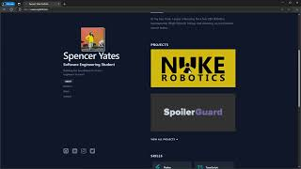
Video Demonstration

Slide 6
What I Learned
RLS Security within a postgresql database
How to configure a Next.js project
How to host with and connect a database to Vercel
How to handle file uploads to Supabase from the website

Slide 7
What Could Be Improved
Convert my examples on the form pages to previews
Time sensitive sessions for logged in users

